Slide 1
ENG4118/5326 - Robotics 4/M Sensors, Actuators and Image capture, processing and analysis
Lecture 8
Kevin Worrall

Slide 2
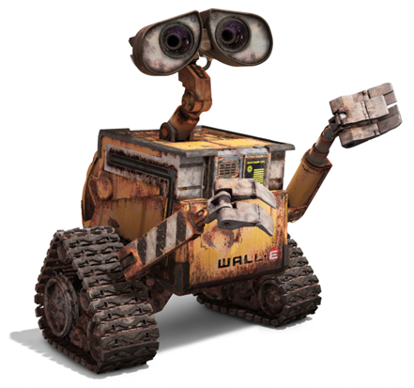
Lecture Overview
Range Finders
Ultrasonic
Optical
Review of proximity sensors
Force Sensors
Strain Gauges
Piezoelectric
Touch and Tactile

Slide 3
Range Finders

Slide 4
Range Finders
Unlike proximity sensors, range finders are used to
find larger distances
detect objects
map the surfaces of objects
Range finders are intended to provide information in advance to the system
Range finders are generally based upon
light such as visible, IR, laser
ultrasonics
Two common methods of measurement are triangulation and time of flight

Slide 5
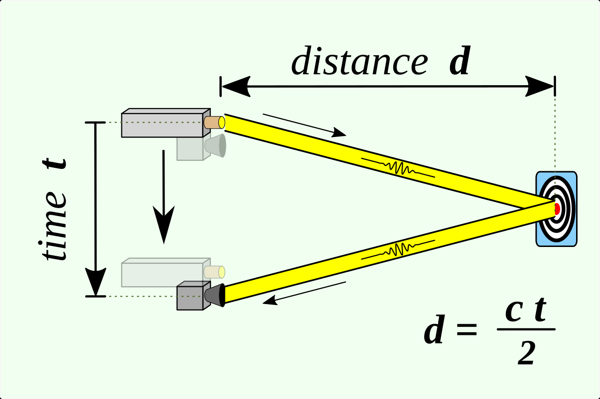
Range Finders – Time of Flight (ToF)
Consists of sending a signal from a transmitter that reflects off an object that is detected by the receiver
The distance between the sensor and object is half the distance travelled by the signal and is calculated from the time of travel and speed of the signal

Slide 6
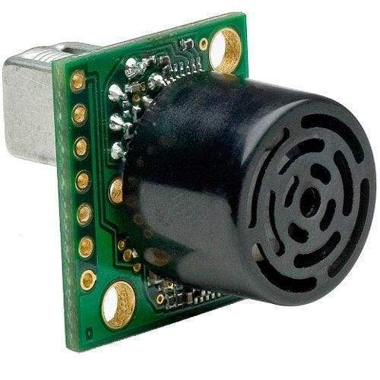
ToF Range Finders – Ultrasonic
An ultrasonic signal (typically>200kHz) is transmitted by a piezoelectric ceramic disk
A receiver detects any reflections from a surface in proximity to the sensor
Sensing range can be in the region of meters and can be used for range finding
…but be aware of materials

Slide 7
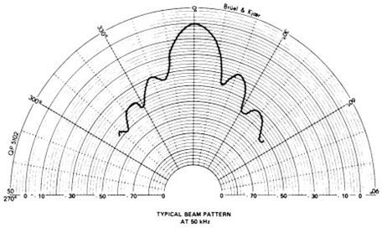
ToF Range Finders – Ultrasonic
Ultrasonic rangefinders operate in the region 20kHz – 2MHz
Resolution improves as the frequency increases (resolution is approximately +/- half a wavelength)
Range and beam width increase as the frequency decreases
Modern industrial environments can have ‘noisy’ emissions in regions below 100kHz which can degrade performance at these frequencies
Ultrasonic range finders are rugged, simple, inexpensive and use low power
Be aware of the cone size and the angle of attack

Slide 8
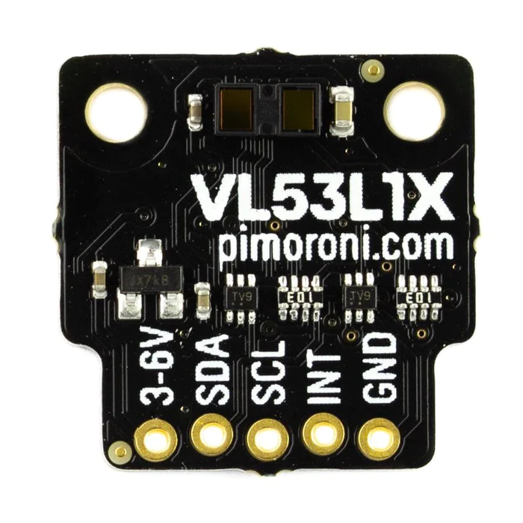
ToF Range Finders – Laser
Same principle but uses a low lower laser source instead of sound waves
Typically - 940 nm invisible laser
4-400cm range (27° field of view)

Slide 9
Range Finders – Triangulation
Involves illuminating an object by a single ray of light that forms a spot on the object.
The spot is detected by the receiver and the range, or depth, is calculated from the triangle formed between the receiver, light source and spot on the object
Normally optical based

Slide 10
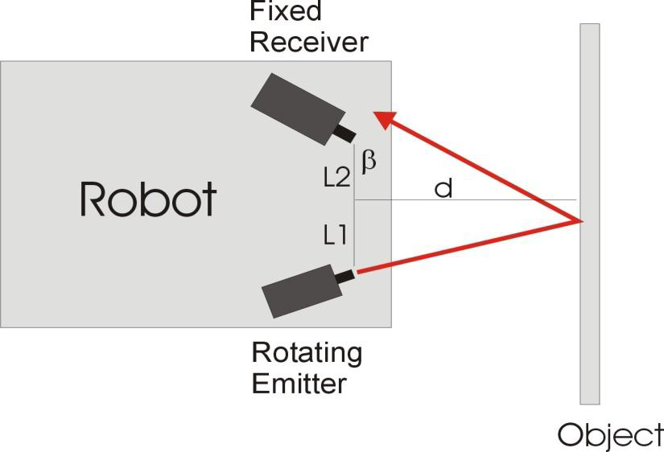
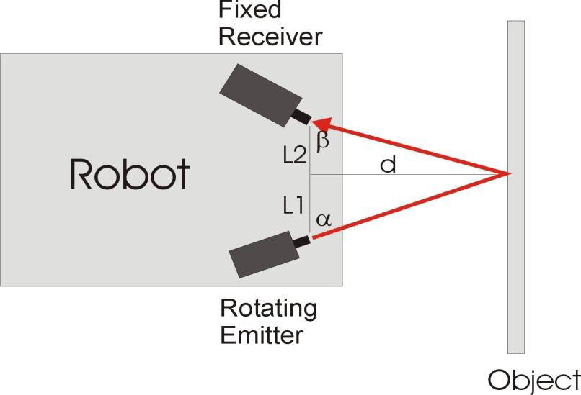
Range Finders – Triangulation
A rotating light emitter (usually from either a Laser or LED) projects a beam of light on to a nearby object which is reflected towards the sensor
If no input is detected by the fixed receiver (aligned along fixed angle β) the emitter is rotated until light is detected by the receiver with the emitter is at some angle α

Slide 11
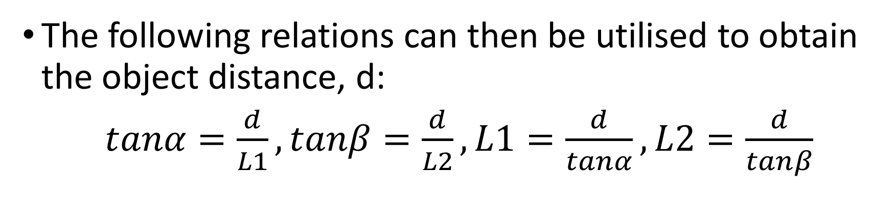
Range Finders – Triangulation
The following relations can then be utilised to obtain the object distance, d:
$tanα=\frac{d}{L1},tanβ=\frac{d}{L2},L1=\frac{d}{tanα},L2=\frac{d}{tanβ}$

Slide 12
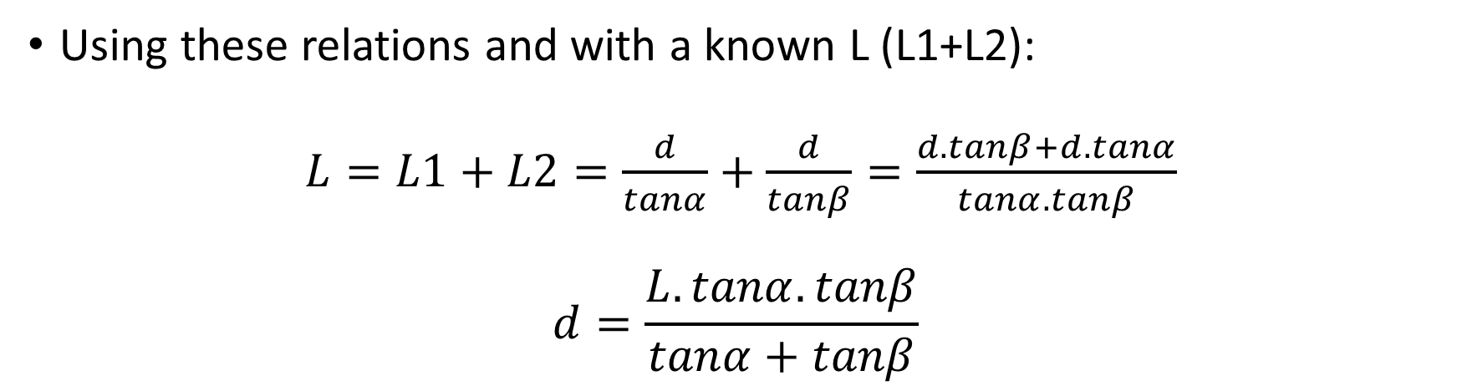
Range Finders – Triangulation
Using these relations and with a known L (L1+L2):
$L=L1+L2=\frac{d}{tanα}+\frac{d}{tanβ}=\frac{d.tanβ+d.tanα}{tanα.tanβ}$
$$d=\frac{L.tanα.tanβ}{tanα+tanβ}$$

Slide 13
Proximity and Range Sensor Summary
Sensor | Range | Object Material
Microswitches | 0 | Any solid
Eddy Current | <20mm typical | Any Metal
Inductive/Hall | <20mm typical | Iron or Steel
Capacitive | <20mm typical | Plastics, liquids, rubber, wood, etc
Optical | Cm's | Reflective
Ultrasonic | meters | Any solid

Slide 14
Force Sensors

Slide 15
Force Sensors
Mostly used as External Sensors associated with overall task control
Forces cannot be measured directly but are estimated through using mechanical elasticity to convert to an equivalent change in length which is measured
Several different forms are available based on the strain gauge elements
Strain gauges sensors
Load cells

Slide 16
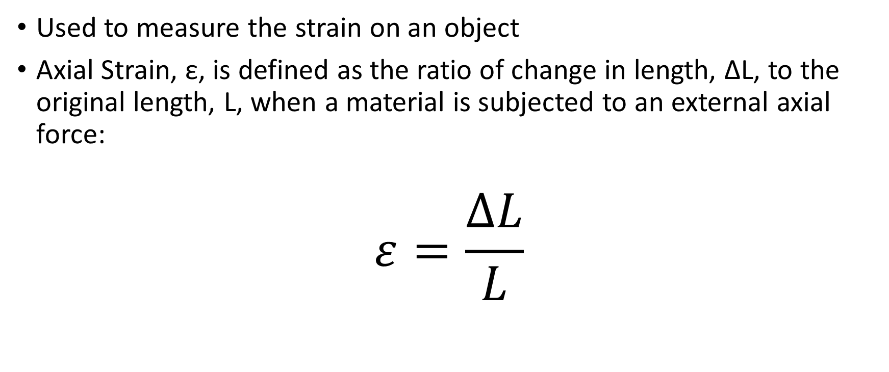
Strain Gauges
Used to measure the strain on an object
Axial Strain, ε, is defined as the ratio of change in length, ΔL, to the original length, L, when a material is subjected to an external axial force:
$$ε=\frac{∆L}{L}$$

Slide 17

Strain Gauges
The electrical resistance, R, of a block of conducing material is proportional to the distance, L, between the parallel faces and the electrical resistivity, ρ, and inversely proportional to the area, A, of the faces:
$$R=\frac{ρ.L}{A}$$

Slide 18
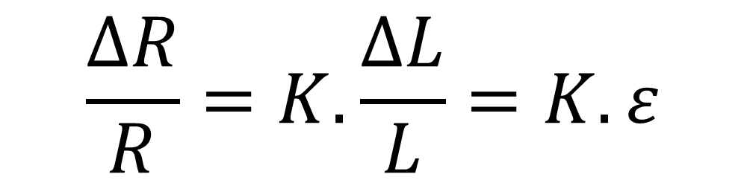
Strain Gauges
The change in resistance in a conducting block of material can be related to the strain on the material, where K is a constant of proportionality termed the Gauge Factor:
$$\frac{∆R}{R}=K.\frac{∆L}{L}=K.ε$$

Slide 19
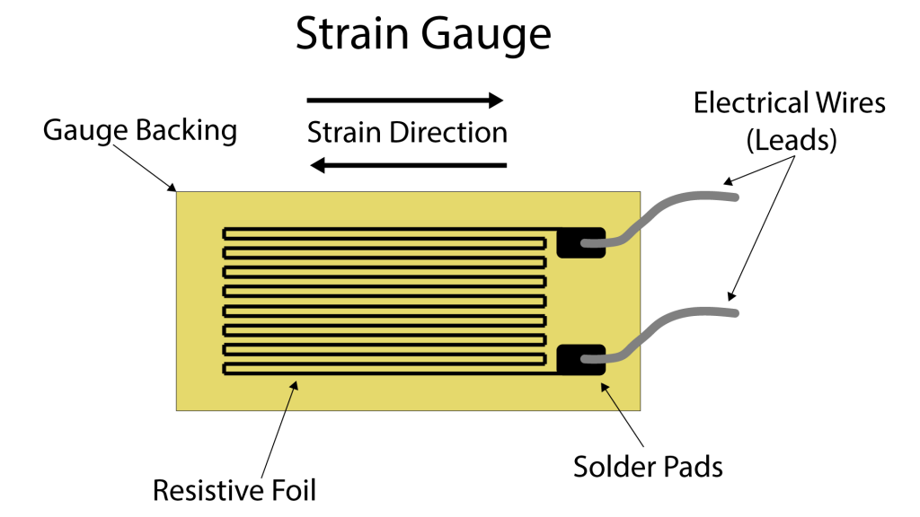
Strain Gauges
Strain gauges can be made from
fine wires glued to a backing sheet,
thin metal foil punched,
etched into the required shape or made from germanium or silicon semi-conductors impregnated with a small quantity of impurities.
The sensitivity of the strain gauge is defined in terms of the gauge factor K
K = relative change in resistance/ relative change in length

Slide 20
Strain Gauges
Material | Composition | Typical Gauge Factor
Manganin | Cu (84%), Mn (12%),Ni (4%) | +0.5
Nichrome | Ni (80%),Cr(20%) | +2.2
Chromel | Ni (64%), Fe (25%), Cr(20%) | +2.5
Nickel |  | +12
Platinum |  | +4.8
Semiconductor |  | >100

Slide 21
Strain Gauges
Although semiconductor strain gauges have very large gauge factors they tend to be:
non-linear,
highly temperature sensitive
more brittle than the other types
more expensive
However, semiconductor strain gauges do offer the prospect of integrated sensor devices that incorporate some signal processing or communications circuitry within the same piece of material

Slide 22
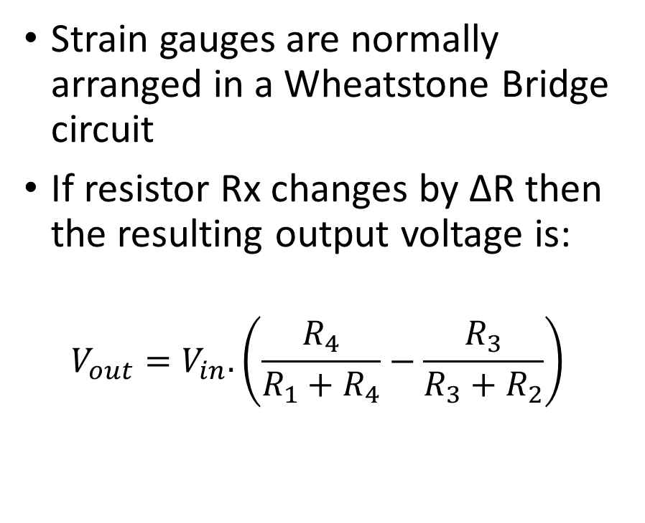
Strain Gauges
Strain gauges are normally arranged in a Wheatstone Bridge circuit
If resistor Rx changes by ΔR then the resulting output voltage is:
$$V_{out}=V_{in}.\left(\frac{R_{4}}{R_{1}+R_{4}}−\frac{R_{3}}{R_{3}+R_{2}}\right)$$

Slide 23
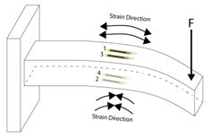
Strain Gauges
A displacement sensor using strain gauges has strain gauges attached to flexible elements in the form of cantilevers. When the element is deformed the strain gauges give a resistance change which can be measured.
This arrangement is typically used to measure displacements between 1 to 30mm and have a nonlinearity error +/-1% of the full range (0-50kN).

Slide 24
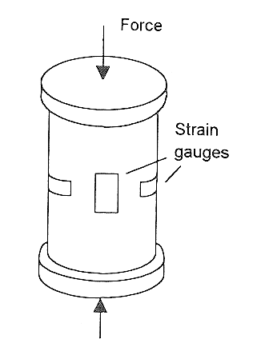
Strain Gauges
Another common force measuring sensor uses strain gauges in the form of load cells.
This consists of a cylindrical tube to which the strain gauge have been attached.
When force is applied to the cylinder it becomes compressed and this is measured as a change in resistance by the strain gauges.
Since temperature also produces a resistance change the signal conditioning circuit has to eliminate these temperature effects.
This arrangement is typically has a nonlinearity error +/-0.05% of full range (50kN-10MN)

Slide 25
Piezoelectric Sensors
Piezoelectric materials (e.g. quartz) generate electric charges when subject to an applied external force.
One face of the material becomes positively charged and the other negatively charged and acts as a capacitor with the resultant potential difference being an indicator of the external force
These sensors are used to measure pressure, force and acceleration
The reverse is also true and if the material is subjected to a voltage then a force is generated which results in compression of the material. (Applied in Ultrasonic range finders )

Slide 26
Piezoelectric Sensors
Piezoresistive materials change resistance proportionally to the applied force.
One of the most common forms employs conductive elastomers (insulating natural or silicon based rubbers made to conduct by the addition of silver or carbon atoms).
Piezoresistive sensors are produced by sandwiching carbon impregnated felt between two metal electrodes. As the mechanical load is increased the carbon fibres are pressed together to reduce the resistance of the felt.

Slide 27
Touch and Tactile Sensors

Slide 28
Touch and Tactile Sensors
Touch sensors are devices that transmit a signal when physical contact is made
Simplest form of this are the microswitches discussed previously that turn on or off when contact is when made
More sophisticated forms of this sensor incorporate the magnitude of the contact force into the generated signal
Tactile sensors are defined as collections of touch sensors
In addition to determining contact, they also provide additional information about the object

Slide 29
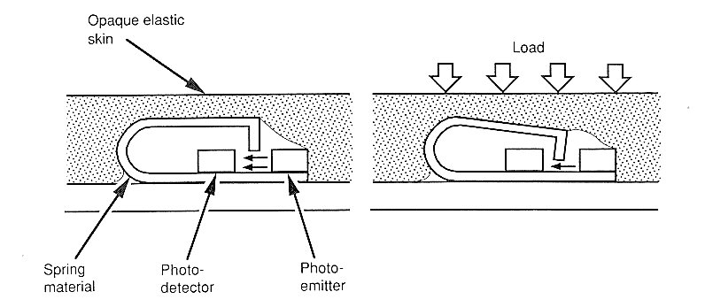
Touch and Tactile Sensors
This additional information can be about shape, size or material type
These touch sensors are arranged in an array or matrix form
Each touch sensor is made up of a plunger, an LED and a light detector

Slide 30
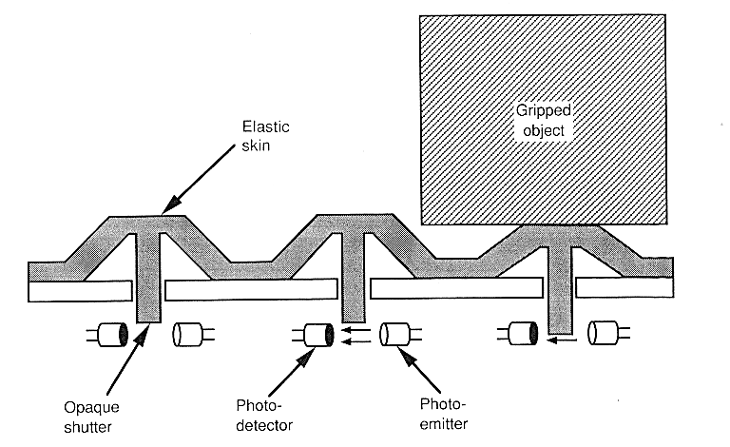
Touch and Tactile Sensors
When contact is made the sensor closes and the plunger interrupts the detection of the light emitted from the LED
The output from the light sensor is proportional to the displacement of the plunger
These touch sensors are basically displacement sensors and therefore alternatives such as pressure sensors, LVDTs, magnetic sensors etc. could be used.

Slide 31

Touch and Tactile Sensors
As a tactile sensor encounters an object, different touch sensors will act differently and in different orders depending on the size and shape of the object.
This information is used by the controller to determine the size and shape of the object.
For each of the object shapes in contact this creates a unique signature which can be used for object detection.

Slide 32
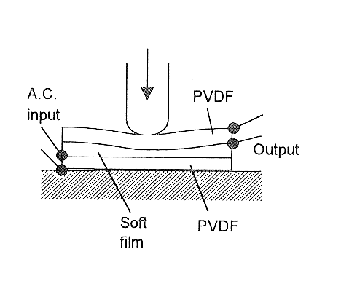
Piezoelectric Tactile Sensors
Polyvinylidene Flouride (PVDF) is a material which exhibits a very large piezoelectric effect
Using two layers of PVDF sandwiching a soft film, the lower layer has an A.C. potential applied across it resulting in oscillations which are transmitted through the film to the upper PVDF layer
When pressure is applied these oscillations change which in turn changes the A.C. output of the system
These sensors are used to determine when a robotic hand has encountered an object or when a mobile robot has come up against an obstacle

Slide 33
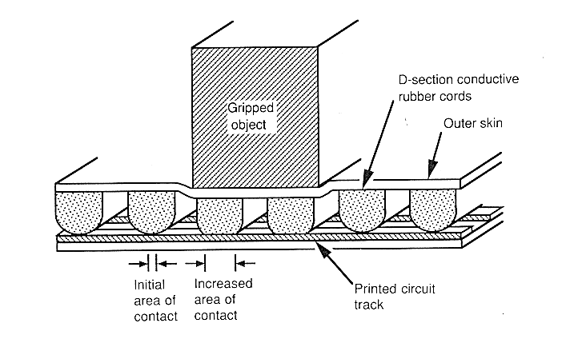
Piezoelectric Tactile Sensors
Applied load leads to a change in the distance between the two foil electrodes and therefore a change in resistance
These types of sensors are used to determine object or obstacle contact

Slide 34
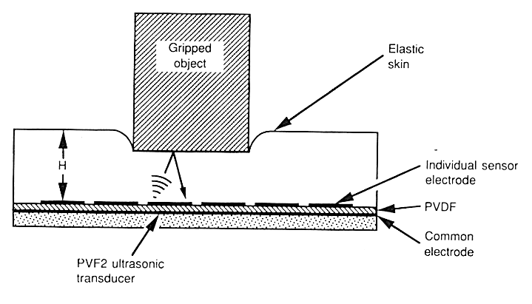
Ultrasonic Tactile Sensors
By transmitting ultrasonic waves through an elastic medium (or skin) the change in thickness of this layer can be determined when it is in contact with an object.
An ultrasonic wave is transmitted through the medium and reflected at the interface of the medium.
The reflected wave exerts a force on the PVDF layer which produces a current proportional to this applied force.

Slide 35
Tactile Sensors using Light Guides
light guide can be made from a sheet of clear plastic material (e.g. perspex) using principles of total internal reflection where the refractive indices of the mediums determine the amount of light reflected from the interface between the materials

Slide 36
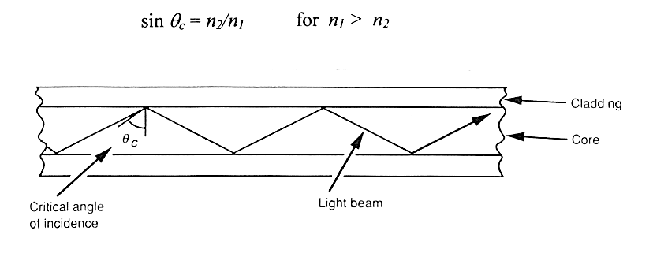
Tactile Sensors using Light Guides
Total internal reflection occurs when light is propagating in the denser of the two mediums and strikes the interface at an angle greater than some critical angle θ_{c}

Slide 37
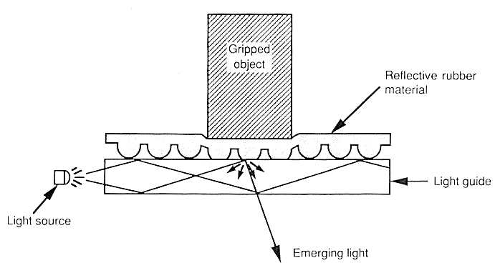
Tactile Sensors using Light Guides
In the case of a Perspex light guide, propagation along the guide will take place provided that the air/Perspex angle is greater than about 42 degrees.
If this is distorted the angle is changed and light escapes through the opposite side of the guide.
The change in the amount of light detected is sensed using a photodiode array.

Slide 38
Review
Range Finders
Ultrasonic
Optical
Review of proximity sensors
Force Sensors
Strain Gauges
Piezoelectric
Touch and Tactile

Slide 39
References
Emanuel, P. and Leff, E., Introduction to Feedback Control Systems, McGraw-Hill Kogakusha, Tokyo, 1976
Bolton, W., Mechatronics, Longman, 1999
Fu, K.S., Gonzales, R.C. and Lee, C.S.G., Robotics, McGraw-Hill, New York, 1987
Niku, S.B. , Introduction to Robotics, 2nd Edition, Wiley, New Jersey, 2011

